Slide 1




NEXT GEN EMPLOYABILITY PROGRAM
Creating a future-ready workforce
Team Members
College Name
Student Name :DHANU PRIYA J
Student ID :au511321104020
KINGSTON ENGINEERING COLLEGE,VELLORE

Slide 2

CAPSTONE PROJECT SHOWCASE
Project Title
Building Bus Reservation System using Python and Django
Abstract | Problem Statement | Project Overview | Proposed Solution | Technology Used | Modelling & Results | Conclusion

Slide 3
Abstract
In today's fast-paced world, efficient transportation systems are essential for smooth urban mobility. This project focuses on the development of a Bus Reservation System using Python and Django framework, aiming to streamline the process of booking and managing bus tickets. The system allows users to search for available buses based on various parameters such as origin, destination, date, and time, providing them with a seamless booking experience.
Key features of the system include user authentication and authorization, allowing both guests and registered users to book tickets. Administrators can manage buses, routes, and schedules, ensuring optimal utilization of resources. The system employs a robust database schema to store relevant information such as bus details, seat availability, and user bookings.
Frontend interfaces are designed using HTML, CSS, and JavaScript, ensuring a responsive and intuitive user experience. Additionally, the system integrates payment gateways for secure online transactions, enhancing convenience for users.
Overall, this project demonstrates the power of Python and Django in building sophisticated web applications, offering a practical solution for managing bus reservations efficiently in today's digital age.
Source :

Slide 4
Problem Statement
Conventional bus reservation systems suffer from inefficiencies such as cumbersome booking processes, limited search options, and inadequate management tools. To address these issues, this project aims to develop a user-friendly Bus Reservation System using Python and Django. Key challenges include designing an intuitive interface, implementing efficient search algorithms, ensuring security, managing scalability, and integrating secure payment gateways. The system will provide passengers with an intuitive platform to search for available buses based on various criteria and seamlessly book tickets online. It will also offer administrators comprehensive tools for managing buses, routes, schedules, and user bookings. By tackling these challenges, the proposed system seeks to enhance booking convenience for passengers while streamlining bus management processes for administrators, ultimately improving efficiency and customer satisfaction in the transportation sector.
Source :

Slide 5
Project Overview
The Bus Reservation System project aims to revolutionize the way bus bookings are made and managed by leveraging the power of Python and Django. This comprehensive system will offer users a seamless booking experience through an intuitive interface, allowing them to search for buses based on various parameters such as origin, destination, date, and time. The system will prioritize user-friendliness, ensuring that passengers can effortlessly navigate through the booking process and make secure transactions online. On the administrative side, the system will empower administrators with robust tools to efficiently manage buses, routes, schedules, and user bookings. By centralizing and automating these processes, the system aims to enhance operational efficiency and streamline bus management operations.
Built on Django's Model-View-Template (MVT) architecture, the project will ensure scalability and maintainability while adhering to industry-standard security practices. The system will implement efficient search algorithms to deliver quick and accurate results, enhancing the overall user experience. Additionally, integration with secure payment gateways will enable users to make online transactions confidently, further improving convenience. Through iterative development and rigorous testing, the Bus Reservation System project seeks to deliver a reliable and user-centric solution that addresses the shortcomings of traditional bus reservation systems, ultimately contributing to improved efficiency and customer satisfaction in the transportation sector.
Source :

Slide 6
Proposed Solution
The proposed solution for the Bus Reservation System project involves the development of a user-friendly web application using Python and Django. The system will feature a responsive frontend interface designed with HTML, CSS, and JavaScript to ensure seamless navigation and booking for users. Through Django's Model-View-Template (MVT) architecture, the backend will be structured efficiently, allowing for scalability and maintainability.
Key functionalities of the system will include a comprehensive search feature, enabling users to find available buses based on criteria such as origin, destination, date, and time. Users will be able to register and log in securely, accessing personalized features such as booking history and preferences. Administrators will have access to a dedicated dashboard where they can manage buses, routes, schedules, and user bookings with ease.
To ensure security, the system will implement robust encryption mechanisms and authentication protocols. Secure payment gateways will be integrated to facilitate smooth and secure online transactions. Additionally, the system will be designed to handle scalability challenges, accommodating a large number of users and transactions while maintaining optimal performance.
Source :

Slide 7
Through iterative development and continuous testing, the proposed solution aims to deliver a reliable and user-centric Bus Reservation System that enhances booking convenience for passengers and streamlines bus management operations for administrators. By addressing the shortcomings of existing reservation systems, the proposed solution seeks to contribute to improved efficiency and customer satisfaction in the transportation sector.
Moreover, robust security measures, including encryption protocols and secure payment gateways, will be integrated to safeguard user transactions and personal information. By continuously refining the system through iterative development and rigorous testing, the proposed solution aims to deliver a reliable and user-centric Bus Reservation System. Ultimately, this system seeks to enhance overall efficiency and customer satisfaction within the transportation sector by addressing the shortcomings of existing reservation systems and providing an enhanced booking experience for all stakeholders involved
Source :

Slide 8

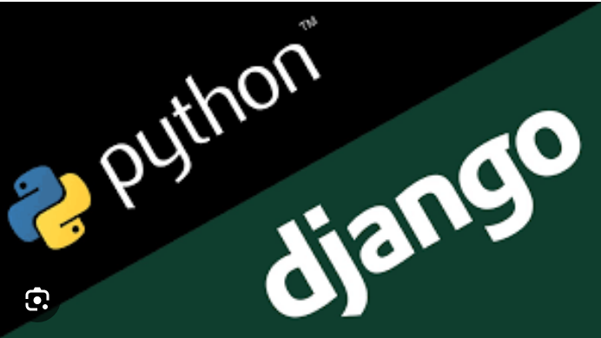
Technology Used
Front-end
Back-end
Source :

Slide 9
Modelling & Results
The Bus Reservation System, built upon Django's ORM, encompasses a series of key models to effectively manage data and facilitate seamless interactions. These models include Bus, Route, Schedule, User, and Booking. The Bus model stores pertinent information about each bus, such as its capacity and unique identifier, while the Route model defines the available travel paths, detailing origin, destination, distance, and estimated travel time. The Schedule model orchestrates departure and arrival times for each route, alongside trip frequency, ensuring comprehensive management of travel logistics. Furthermore, the User model encapsulates user data, offering a secure repository for account details such as usernames, emails, and hashed passwords. Lastly, the Booking model bridges users and their reservations, associating specific bookings with users, buses, and schedules, thus facilitating the reservation process seamlessly.
Users will enjoy the ability to effortlessly search for buses based on various criteria, access detailed information about available routes and schedules, and securely register, log in, and manage their bookings. Administrators, on the other hand, will wield comprehensive control over system components, allowing them to add, edit, or remove buses, routes, and schedules, oversee user accounts and bookings, monitor bus occupancy, and derive valuable insights through generated reports and analytics. Continuous monitoring and optimization strategies will ensure that the system maintains optimal performance, delivering prompt responses, high user satisfaction, and scalable operations to meet the evolving needs of both users and administrators effectively.
Source :

Slide 10
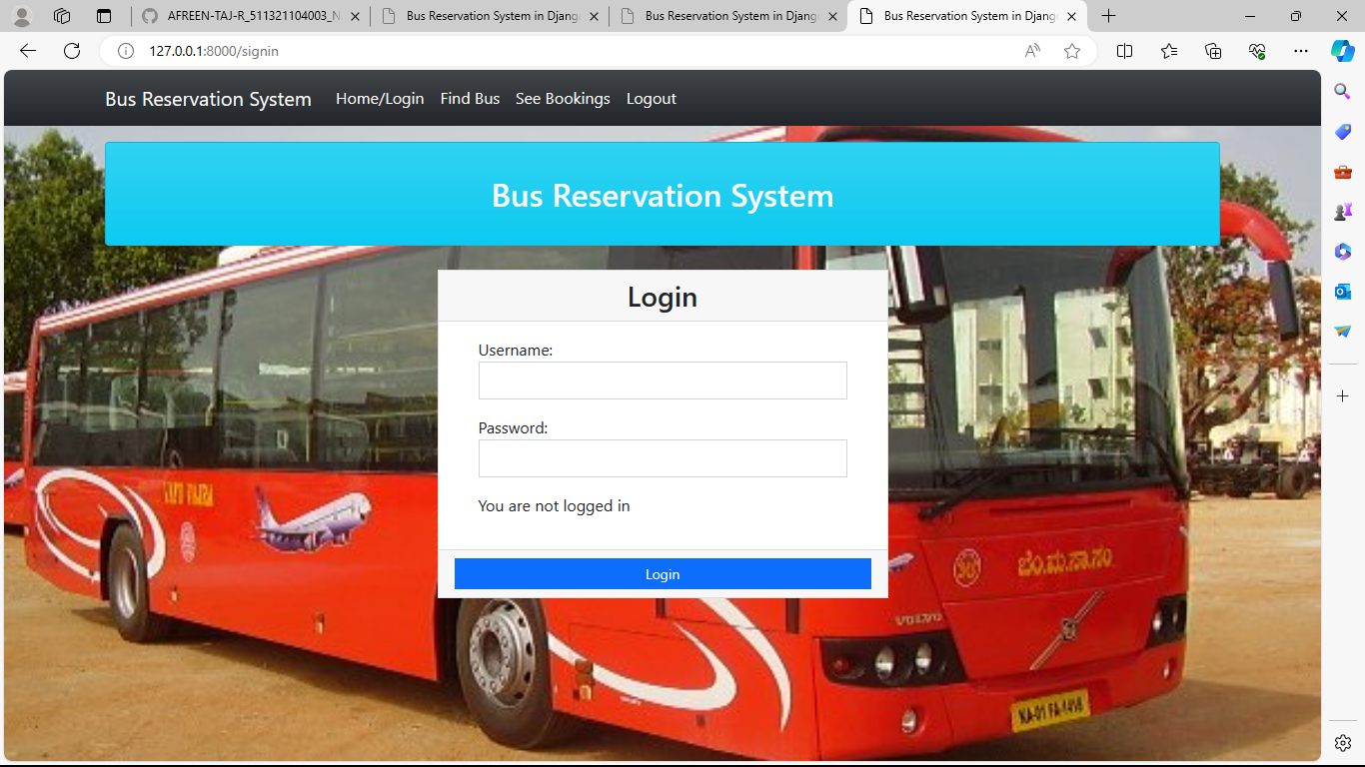
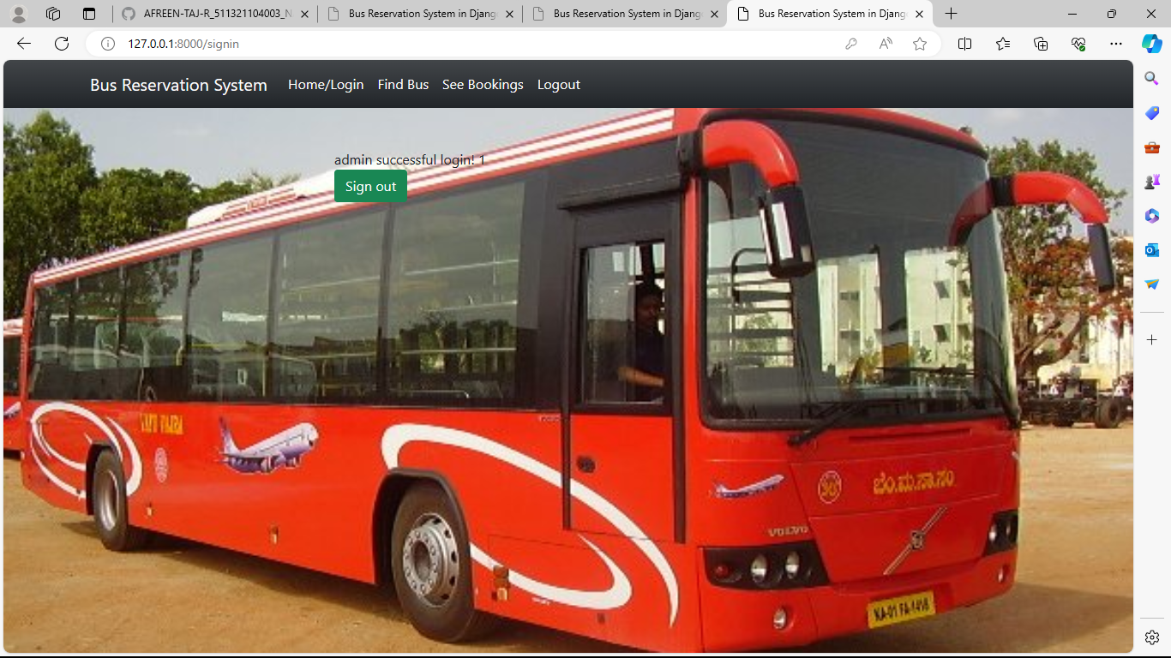
Homepage

Slide 11
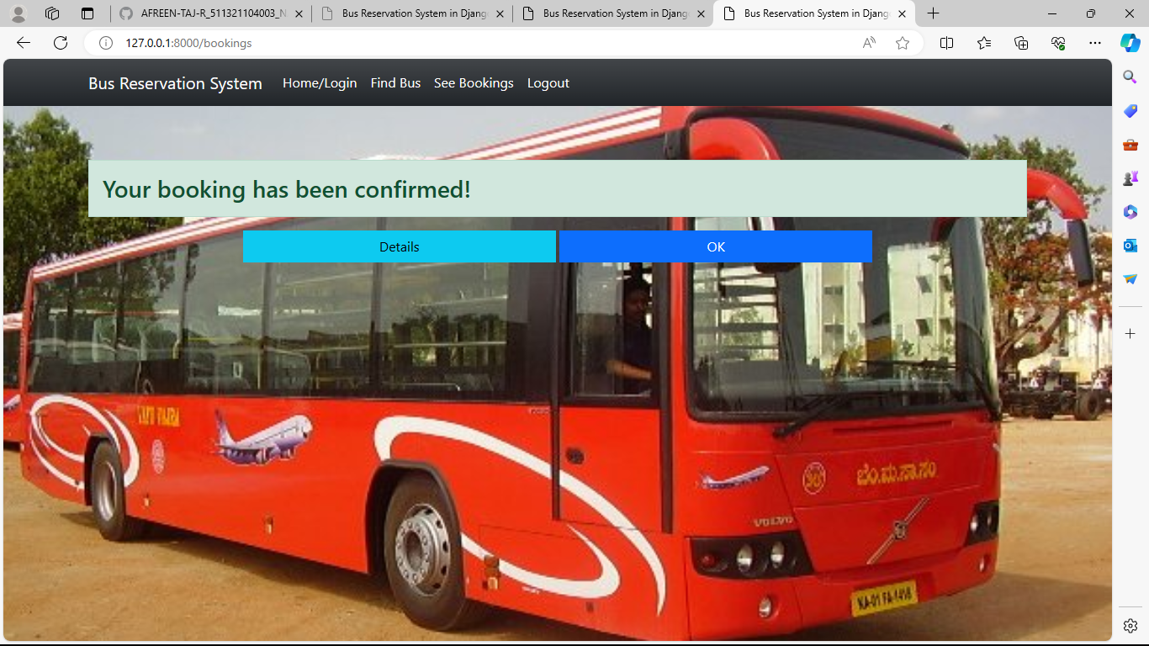
About-Us-Page

Slide 12
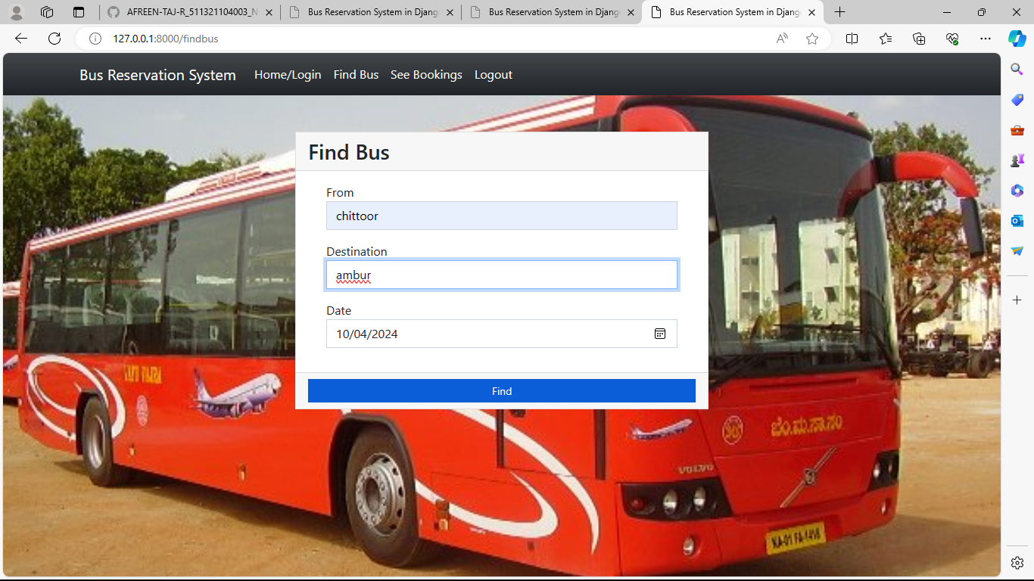
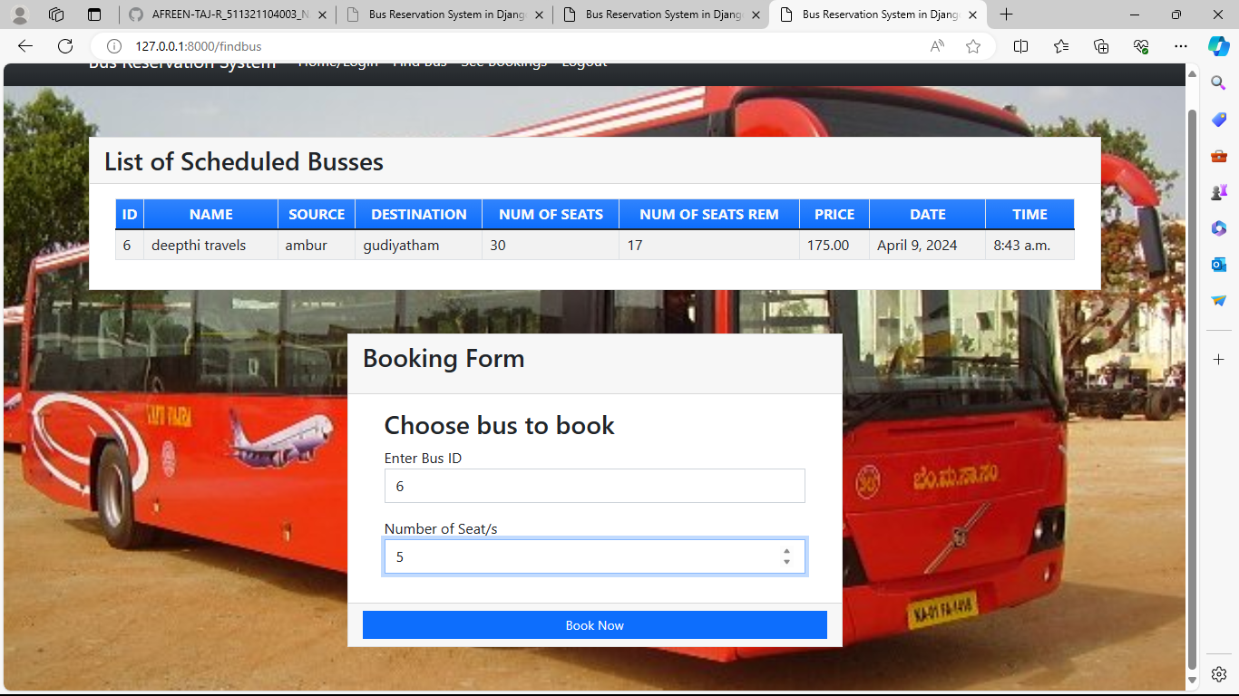
Service-Page

Slide 13
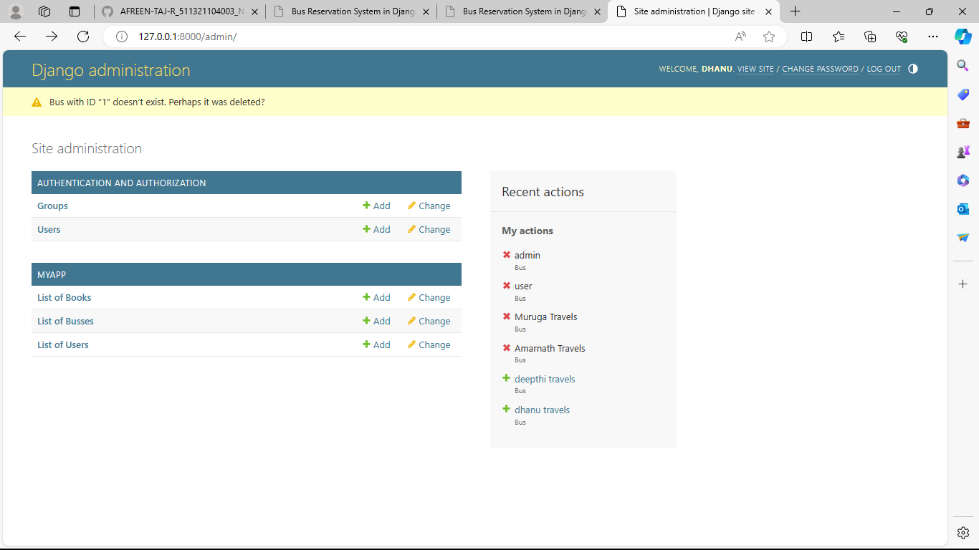
Departments-Page

Slide 14
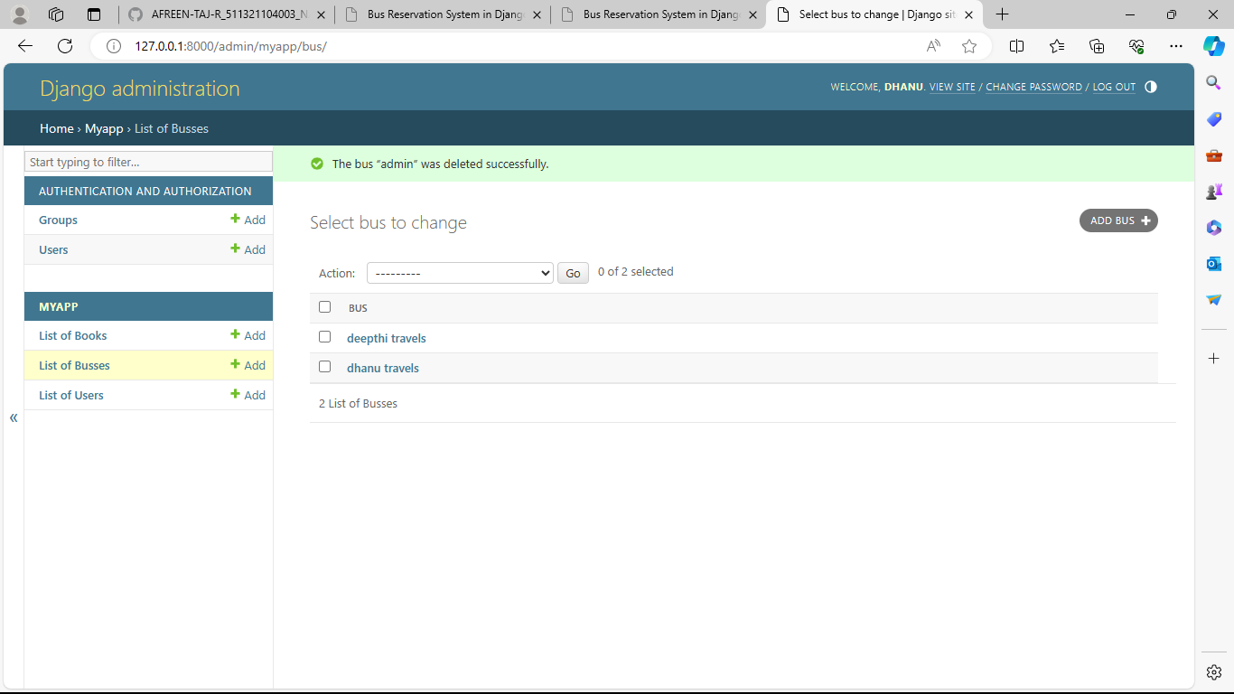
Blog-Page

Slide 15
Future Enhancements:
In the realm of future enhancements for the Bus Reservation System, several avenues could be explored to further elevate its functionality and user experience. One potential avenue is the development of a dedicated mobile application, extending accessibility to users across various devices and providing a seamless booking experience on the go Another area for enhancement is the implementation of real-time tracking features within the system. Integrating real-time GPS tracking of buses would enable users to monitor the exact location of their booked buses, receive accurate arrival time estimates, and make more informed travel decisions. This feature would significantly improve the overall travel experience for users by reducing uncertainty and waiting times at bus stops.
Advanced analytics capabilities could also be integrated into the system to provide administrators with deeper insights into user behavior, booking patterns, and revenue trends. By leveraging data analytics techniques, administrators can make data-driven decisions to optimize business operations, improve service offerings, and maximize revenue generation. Other potential enhancements include multilingual support to cater to a diverse user base, integration with other transportation networks for seamless multi-modal travel planning, accessibility features to accommodate users with disabilities, social media integration to foster user engagement and organic growth, and feedback mechanisms to gather user feedback and suggestions for continuous improvement. By exploring these avenues for future enhancements, the Bus Reservation System can evolve into a more comprehensive and user-centric platform that meets the evolving needs and preferences of its users.

Slide 16
Conclusion
In conclusion, the Bus Reservation System represents a significant advancement in the realm of transportation management, offering users a seamless and convenient platform for booking bus tickets. Through the utilization of Python and Django technologies, the system provides robust functionalities such as efficient search algorithms, secure user authentication, and comprehensive administrative tools. As demonstrated, the system addresses common challenges associated with conventional reservation systems, enhancing both user experience and administrative efficiency. Looking ahead, the future enhancements outlined present exciting opportunities to further elevate the system's capabilities and cater to the evolving needs of users and administrators. From the development of a dedicated mobile application to the integration of real-time tracking features and implementation of rewards programs, these enhancements promise to enrich the user experience, drive engagement, and optimize business operations.
Ultimately, the Bus Reservation System stands as a testament to the power of technology in transforming traditional processes, streamlining operations, and enhancing overall efficiency and customer satisfaction within the transportation sector. By continuing to innovate and evolve, the system has the potential to become a cornerstone in the realm of transportation management, setting new standards for convenience, accessibility, and user-centricity in the booking process.
Source :

Slide 17
Thank You!
Notes:
Thank You !!

